Slide 1
EE368 Face Detection Project
Angi Chau, Ezinne Oji, Jeff Walters
28 May, 2003

Slide 2
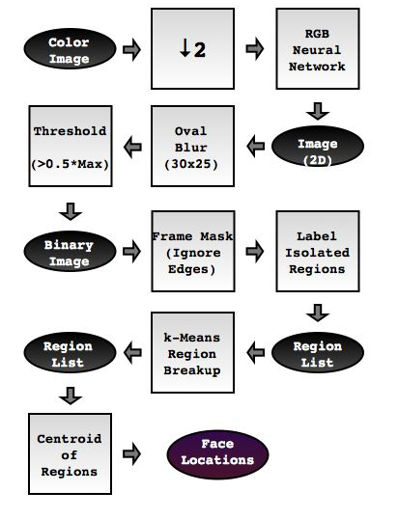
High-Level System Design
Face Color Detection
Region of Interest Isolation
Final Decison

Slide 3
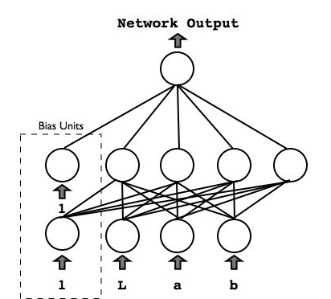
Skin Color Detection: Neural Network
TRAINING
Stochastic Backpropagation
Training patterns pre-whitened.
Learning rate, η, decreased with each training epoch.
Train on equal number of skin and non-skin pixels.
Training takes 10 minutes.
NETWORK TOPOLOGY AND COLORSPACE CHOICES
Choose number of hidden units
Pixel color can be expressed in multiple colorspaces
  RGB Lab, XYZ, and HSV
  RGB provided fewest false positives
RUNNING
Extremely Efficient
  All image pixels can be processed in under 1s.

Slide 4
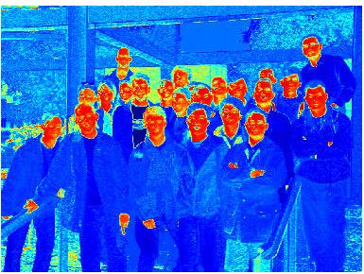

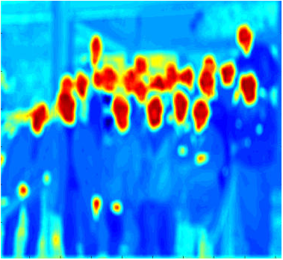
Isolate Face Shapes: Convolving with Mask
Resulting image from neural net had regions of interests that were not true faces.
The unique oval-shape true faces was used.
To isolate most probable regions of interest, the test image is convolved with an oval mask.

Slide 5
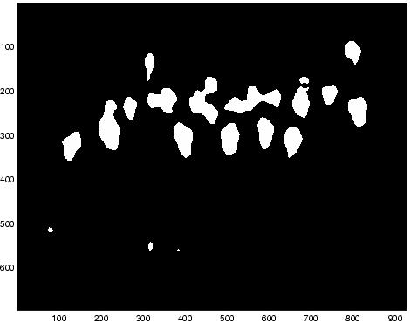

Narrowing Possible Face Locations
Increases speed of detection algorithm.
Test images showed that the faces were usually clustered.
We risk eliminating true faces, but we reject more false positives.

Slide 6


Split Multi-Face Images: k-Means Clustering
Regions may contain more than one face.
Estimate number of faces using the Distance Transform
  Use this estimate to initialize k.
Feature vectors are (x,y) locations of each pixel in the region.
Assign each pixel to one of k new regions.

Slide 7
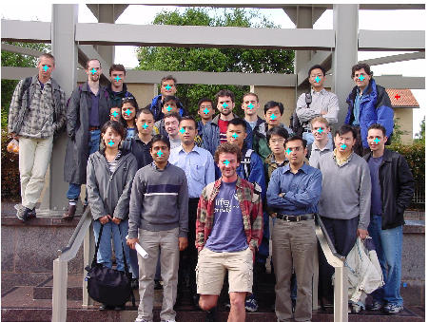
Results on Training Images
 | Misses | Repeats | False Pos
Image 1 | 2 | 0 | 0
Image 2 | 2 | 3 | 3
Image 3 | 1 | 0 | 1
Image 4 | 3 | 0 | 0
Image 5 | 1 | 1 | 1
Image 6 | 2 | 0 | 0
Image 7 | 3 | 1 | 0
System runtime under 10s on average
Simplest algorithm actually worked best!

Slide 8
Problems Encountered
Differences amongst colorspaces
  e.g., Lab misidentifies red shirts as skin.
  Final implementation used RGB neural net only.
System parameters
  Threshold for finding peaks during face color detection.
  Aggressiveness of the k-means region breakup.
  Finding the optimal set of parameters is a hard problem.

Slide 9
Failed Approaches
Adaptive thresholding for face color detection.
Morphological operations to clean up color segmentation results.
Eigenfaces
Template matching
  Average face
  Average eyes
  Average “eye-frames”
  Difficult to interpret correlation results.

Slide 10
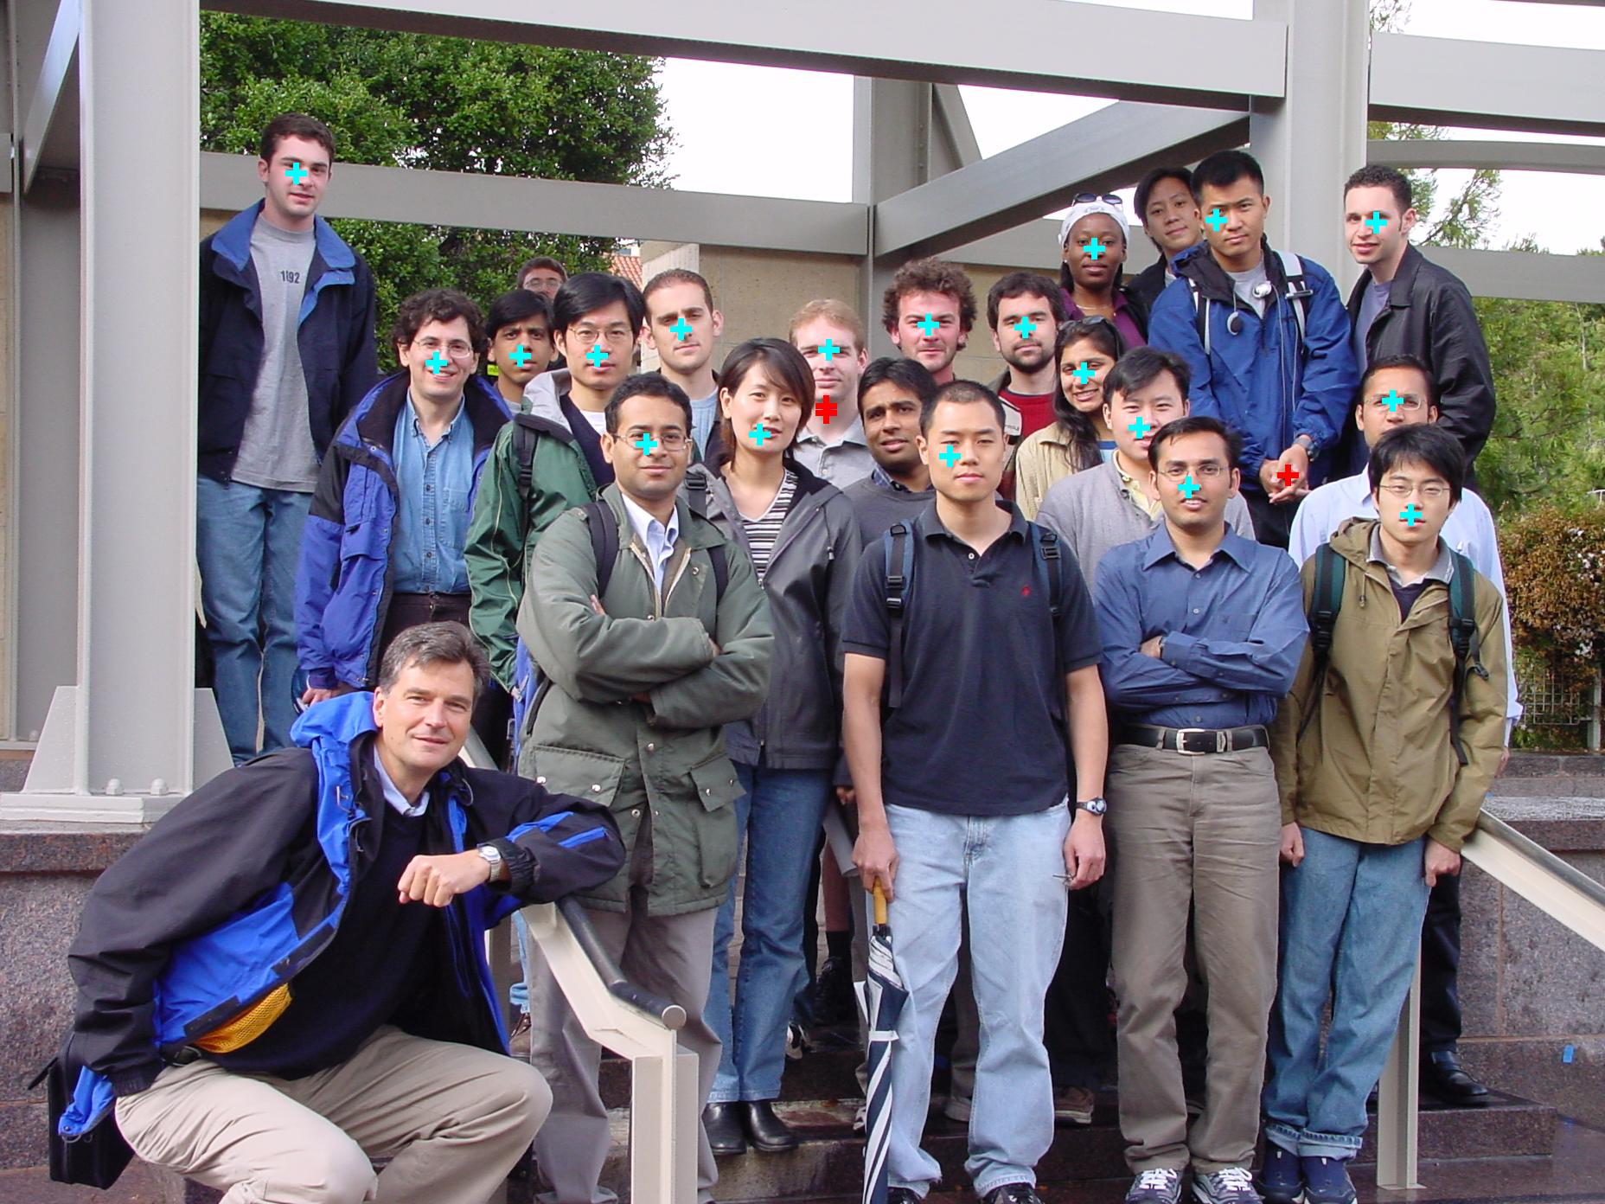

Slide 11
